Slide 1

ECG INTERPRETATION
COMMON RECORDING ERRORS
BASIC ECG INTERPRETATION
BY
GBADAMOSI TAURID .A

Slide 2
QUESTIONS
1.QRS COMPLEX REPRESENTS VENTRICULAR DEPOLARIZATION
A. YES B. NO C. NOT SURE
2.A P WAVES OF 0.12SEC IS
A. PROLONGED B. WIDENED C. NORMAL
3.THE AMPLITUDE OF P WAVES IS
A. >2.5MM B. >2.5MS C. <2.5MM
4.WHICH LEAD SHOWS THE TALLEST R WAVES IN ECG.
A. LEAD II B. LEAD V5 CI
5.NORMAL QTc in FEMALES
A.<0.50 SEC B.<0.46SEC C.>.46

Slide 3
OBJECTIVES
AT THE END OF THE LESSON,WE SHOULD BE ABLE TO:
TO KNOW AND RECOGNISE THE DIFFERENT ECG WAVES AND THEIR NORMAL VALUES.
SHOULD KNOW YOUR INTERPRETATION PATTERN.
SHOULD KNOW THE IMPORTANCE OF SOME WAVES AND INTERVALS

Slide 4
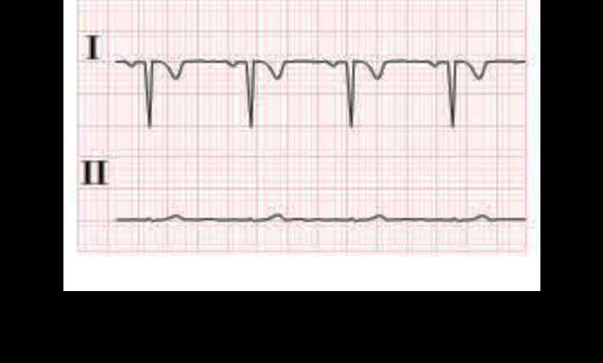
COMMON LEAD ERRORS
THE MOST COMMON ERROR THAT OCCURS DURING ECG RECORDING ARE MAJORLY THAT OF LIMB REVERSAL.
REVERSAL CAN BE LIMB LEAD OR CHEST LEAD AND THIS MIGHT LEAD TO A CHANGE IN THE MORPHOLOGY OF THE RECORDING IN WHICH CASE THE P,QRS OR T WAVES MIGHT BE REVERSED.
WHEN YOU HAVE ALL LEADS REVERSED THEN YOU HAVE GLOBAL LIMB LEAD INVERSION.
ELECTRICAL AXIS BECOMES ABNORMAL.

Slide 5
LEAD ERRORS
IF THE CHEST LEADS ARE REVERSED ,THE ECG RECORDING FOR THE CHEST LEADS WILL BE AFFECTED

Slide 6
BASIC ECG INTERPRETATION
HEARTRATE-THIS IS THE RATE AT WHICH THE HEART BEATS AND THE UNIT IS BEAT PER MINUTES(BPM).
NORMAL RATE IS BETWEEN 60-100bpm
The beat can be regular or irregular as such the calculation for the rate differs.
FOR EASY ECG AND STEP BY STEP INTERPRETATION,THE FOLLOWING PATTERN MAY BE ADOPTED:
REGULAR RHYTHMS-
Here, the R-R intervals are consistent:
USING THE LARGE BOX METHOD
Count the number of large boxes between 2 successive R waves(R-R interval)
Divide it by 300 that is 300/number of large boxes
e.g. Number of large boxes is 4,heartrate 300/4=75bpm

Slide 7
HEART RATE
SMALL BOX METHOD
Count the number of small squares between R-R waves
Divide your value by 1500 that is 1500/R-R interval
Eg if R-R is 20 small squares then rate =1500/20=75bpm
6 SECONDS STRIP METHOD:
Though mostly used for irregular rhythm.
Count how many R waves in a 6 seconds strip(30 large boxes)
Multiply your value by 10 that gives you the heartrate
E.g 7 R waves in 6seconds ,HR=7x10=70bpm

Slide 8
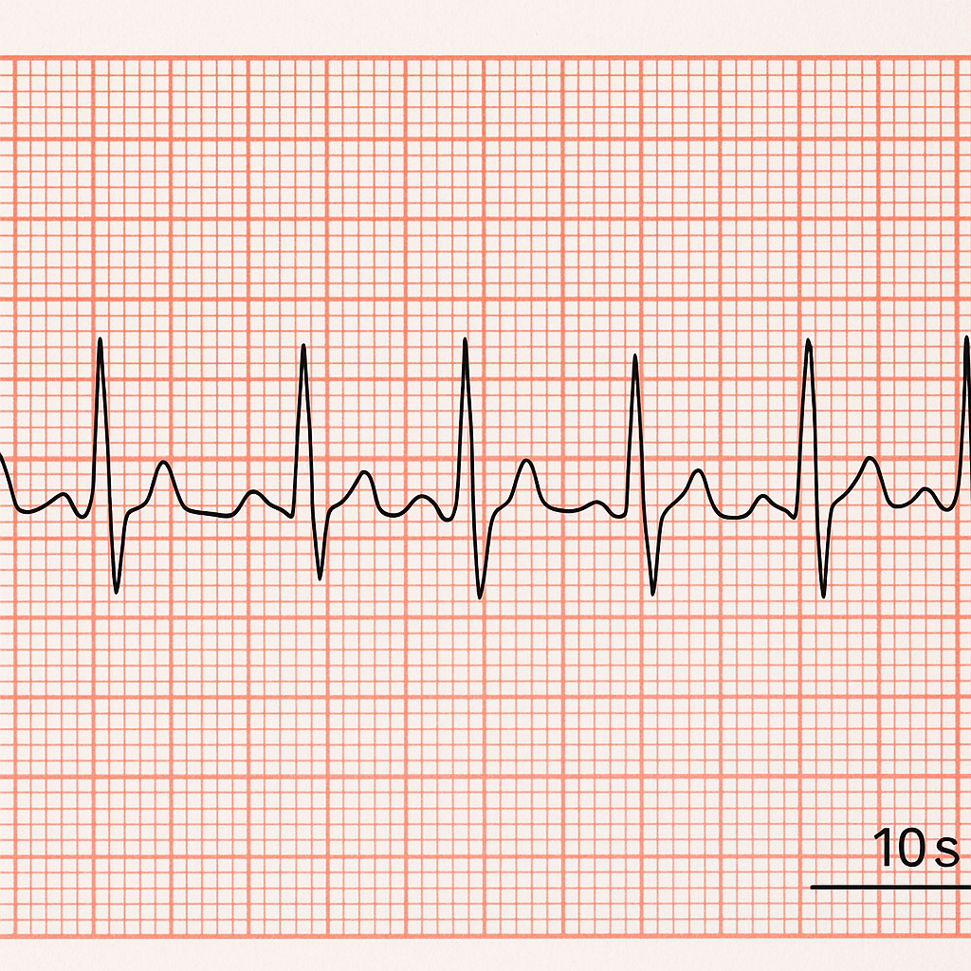
HEART RATE
IRREGULAR RHYTHM e.g Atrial fibrillation
Small or large box method cannot be used here
Use a large long strip especially lead II.
Count the number of QRS in
6 seconds(30 boxes) on paper run at 25mm/s.
Multiply the number by 10 to get heartbeat
(6secx10=60sec=1min)
E.g say in 6-seconds you count 9 QRS complexes:
Heartrate =9x10=90bpm.

Slide 9
HEARTRATE
1O seconds method .
1 large box =5mm=250 small boxes in 10 seconds
1 large box=5mm=250/5=50 large boxes in 10 seconds
In this method you count 50 large boxes and count the number of QRS in them and multiply by 6.
E.g heartrate 14 QRSx6=84bpm

Slide 10
HEARTRATE
NORMAL HEARTRATE IS BETWEEN 60
RATE LESS THAN 60BPM IS BRADYCARDIA
RATE HIGHER THAN 100BPM IS TACHYCARDIA
TYPE OF BRADY OR TACHYCARDIA DEPENDS ON TYPE OF RHYTHM E.G SINUS TACHYCARDIA,ATRIAL TACHYCARDIA,V-TACH,JUNCTIONAL TACHYCARDIA ETC

Slide 11
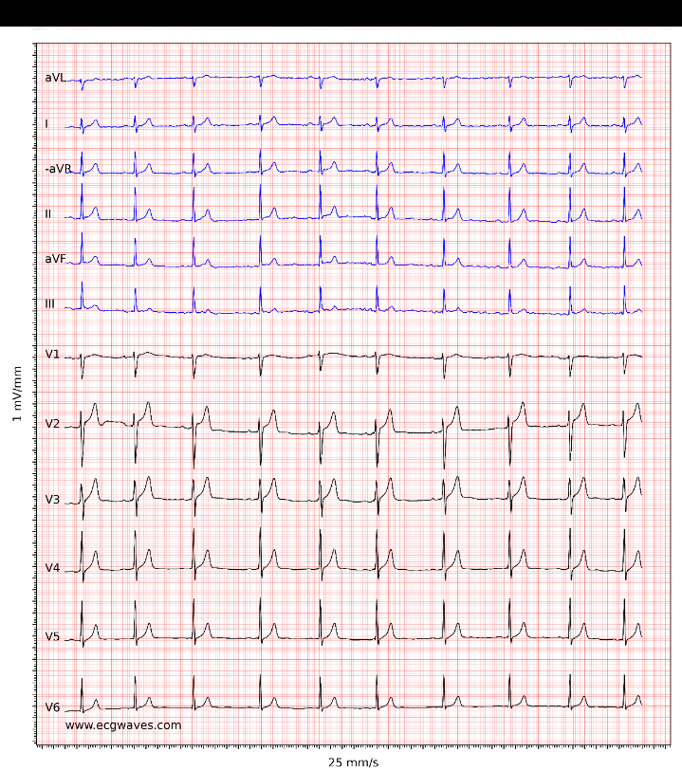
RHYTHM
REGULAR RHYTHM IS ONE IN WHICH :
The P waves is followed by a QRS complex which is in turned followed by a
T waves
The R-R interval is regular
The P waves is upright in I,II,Avf.
The rate is between 60-100bpm
Normal PR interval (0.12-0.20sec)
Narrow QRS ,about 0.10sec and less.
Note: Normal sinus rhythm shows that the SA Node started the cardiac excitation which is always represented by the presence of An upright P waves

Slide 12
AXIS
Axis provides information about the heart’s electrical orientation and can help identify underlying conditions.
It can be Normal or Abnormal
Simple way to determine the axis is to look at the QRS in lead I,IIand aVF.
If QRS in lead I and Avf is positive =NORMAL AXIS.
If lead I positive and Avf negative,check lead II
If positive =normal axis
If negative=left axis deviation.

Slide 13
AXIS
If lead I is negative and Avf is positive=RIGHT AXIS DEVIATION
If lead I is negative and avf is negat0oi[]98ukilo0;pive =EXTREME AXIS(rare)
Possible causes of LAD-left anterior fascicular hemi block, LVH, Inferior MI.
Possible causes of RAD-RVH, pulmonary conditions(PE,COPD),lateral MI
Possible causes of Extreme axis-severe ventricular rhythm disturbance, advance conduction block

Slide 14
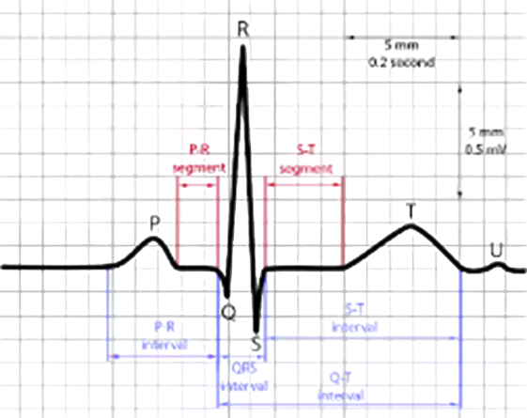
THE ECG GRAPH

Slide 15
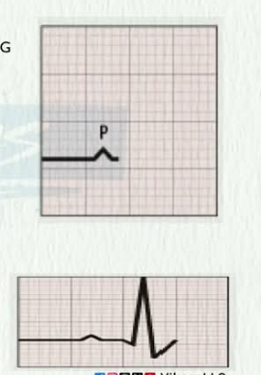
P WAVES
IT REPRESENTS ATRIAL DEPOLARIZATION
IT IS THE FIRST POSITIVE DEFLECTION ON AN ECG
IT IS GENERATED WHEN THERE IS AN IMPULSE
FROM SA NODE.
THE NORMAL VALUE FOR THE P WAVE IS
0.08sec -12sec
IT IS SMOOTH,ROUNDED.
UPRIGHT IN LEAD LEAD I, II, aVF; INVERTED IN Avr
BEST PLACE TO CHECK FOR P WAVES IS LEAD II
AND V1.
IN V1 IT IS MOSTLY BIPHASIC

Slide 16
P WAVES
TO CALCULATE THE P WAVES YOU COUNT FROM BEGINNING OF THE P TO THE END THEN MULTIPLY BY THE CONSTANT 0.04.
NORMAL AMPLITUDE IS 2.5mm.
ABSENT P WAVES +IRREGULAR RHYTHM=ATRIAL FIBRILLATION
LONG P WAVES>0.12sec(LAE) AND “m” PATTERNED P WAVES (P-MITRALE) OR AMPLITUDE MORE THAN 2.5MM (RAE OR P-PULMONALE).
ABSENT, INVERTED( BEFORE, HIDDEN OR AFTER QRS) IS JUNCTIONAL OR NODAL RHYTHM
SA TOOTH APPEARANCE=ATRIAL FLUTTER
P WAVES UNRELATED TO QRS COMPLEXE=AV DISSOCIATION(COMPLETE HEART BLOCK)

Slide 17
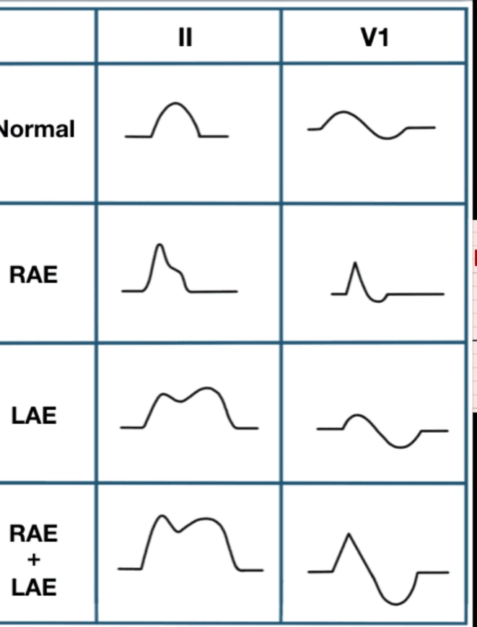
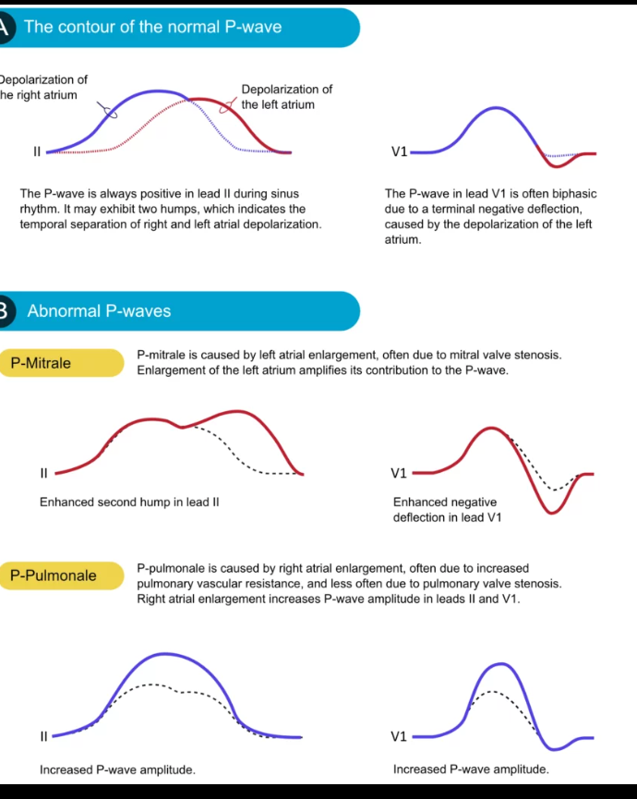
P WAVES

Slide 18
WORD ON MARBLE
“ Money follow value ,value comes from skills not your credentials.”
copied
Skill acquisition, training and re-training is essential to make a living in today’s society.

Slide 19
PR INTERVAL
IT IS THE TIME BETWEEN THE BEGINNING OF THE P WAVES AND THE BEGINNING OF THE QRS COMPLEX.
IT IS THE INTERVAL BETWEEN THE BEGINNING OF ELECTRICAL EXCITATION OF THE ATRIAL AND THE BEGINNING OF EXCITATION OF THE VENTRICLE(SA NODE THROUGH THE ATRIUM,AV NODE,AND BUNDLE OF HIS TO THE VENTRICLES)
DURATION IS BETWEEN 0.12 - 0.20seconds
SHORT PR INTERVAL =WPW(WOLFF –PARKINSON-WHITE ) SYNDROME-ACCESSORY PATHWAY (BUNDLE OF KENT) OR LOWN-GANONG-LEVINE SYNDROME.
PROLONGED PR > 0.20SEC = 1ST DEGREE , 2ND DEGREE AV BLOCKS

Slide 20
QRS COMPLEX
IT REPRESENTS VENTRICULAR DEPOLARIZATION (BY PURKINJE FIBRES)
NORMAL DURATION 0.06 - 0.10SEC
PROLONGED QRS>0.12SEC = BUNDLE BRANCH BLOCK,VENTRICULAR RHYTHM,HYPERKALEMIA
TALL QRS = VENTRICULAR HYPERTROPHY, ATHLETE HEART.
LOW QRS = PERICARDIA EFFUSION, OBESITY, COPD
ABNORMAL Q WAVES = MYOCARDIAL INFARCTION IF IT IS DEEP AND WIDE

Slide 21
ST SEGMENT
IT AN ISOELECTRIC POINT WHERE NO ELECTRICAL ACTIVITY OCCURS.
IT SHOWS THE POINT BETWEEN VENTRICULAR DEPOLARIZATION AND REPOLARIZATION
ABNORMAL ST SEGMENT CAN BE AN ELEVATED ONE SEEN IN S.T.E.M.I OR DEPRESSION IN N.S.T.E.M.I; DOWNSLOPPING AS SEEN IN ISCHEMIA OR STRAIN PATTERN

Slide 22
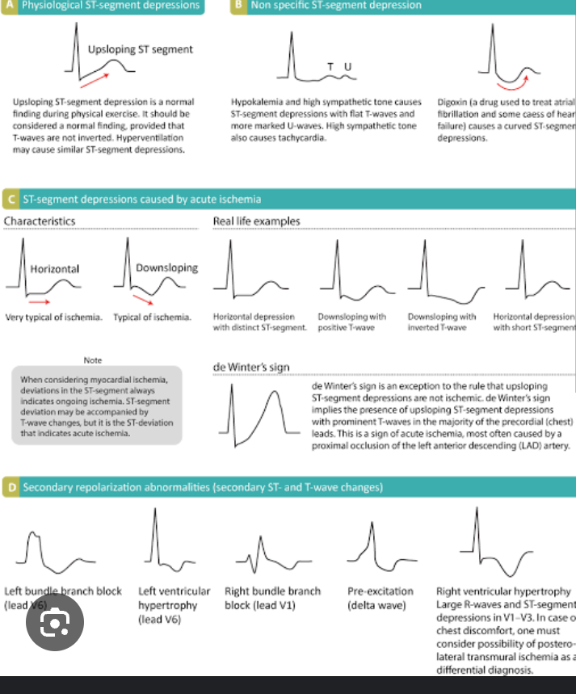
ST SEGMENTS

Slide 23
QT INTERVAL
IT REPRESENTS TOTAL TIME FOR VENTRICULAR DEPOLARIZATION AND REPOLARIZATION
ESSENTIALLY THE PERIOD FROM THE BEGINNING OF VENTRICULAR CONTRACTION TO THE END OF RECOVERY.
SPECIFICALLY REPRESENTS THE ELECTRICAL ACTIVITIES OF THE VENTRICLES.
IT IS <0.44SEC IN MALE AND <0.46SEC IN FEMALES
PROLONGED QT INTERVAL CAN INCREASE THE RISK OF DANGEROUS HEART RHYTHMS ABNORMALITIES SUCH ASN TORSADE DE PONTES A KIND OF V-TACH THAT CAN LEAD TO SUDDEN CARDIAC DEATH.
SHORT QT INTERVAL <0.33-0.34SEC IS CONSIDERED SHORT.
SHORT QT IS NOT COMMON
IT MEANS THAT THE HEART IS REPOLARIZING FASTER THAN NORMAL
MAY CAUSE LIFE THREATENING ARRYTHMIAS SUCH AS V-FIBRILLATION OR SUDDEN CARDIAC DEATH

Slide 24
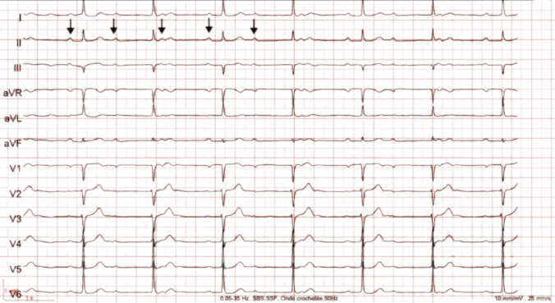
QT INTERVAL

Slide 25
QTC
IT IS CORRECTED QT AND IT IS CALCULATED DUE TO THE RELATIONSHIP BETWEEN QT INTERVAL AND THE HEART RATE
IT ALLOWS FOR MORE ACCURATE ASSESSMENT OF THE QT INTERVAL.
CALCULATED USING BAZETT”S FORMULAR=QT/√R-R
NORMAL VALUE,MEN 0.35-0.445SEC,WOMEN0.35-0.46SEC.
<0.35SEC IS SHORT QTc
SAME EFFECT WITH LONG OR SHORT QT

Slide 26
LEFT VENTRICULAR HYPERTROPHY(LVH)
CAN BE DUE TO LONG STANDING BP OR HEART VALVE DISEASE.
ON ECG IT PRODUCES STRONGER ELECTRICAL SIGNAL ESPECIALLY IN THE CHEST LEADS.
CALCULATIONS OF LVH:
SOKOLOW-LYON CRITERIA(MOSTLY USED)
SV1 +RV5/V6 <35MM(NORMAL) IF >35MM(LVH)
CORNELL CRITERIA=MEN RaVL +SV3<28MM(NORMAL),>28MM(LVH)
WOMEN RaVL+SV3<20MM(NORMAL),>20MM(LVH)
R WAVES IN aVL>11MM(LVH),LESS THAN 11MM(NORMAL)

Slide 27
T WAVES
REPRESENTS VENTRICULAR REPOLARIZATION
TYPICALLY,A NORMAL T WAVES IS UPRIGHT IN MOST ECG LEADS EXCEPT aVR WHERE IT IS INVERTED
THERE ARE SOME ABNORMAL T WAVES:
PEAKED T WAVES SEEN IN HYPERKALEMIA
INVERTED T WAVES SEEN IN ISCHEMIA,PERICARDITIS,MYOCARDITIS ETC
BIPHASIC T WAVES –IT HAS BOTH POSITIVE AND NEGATIVE DEFLECTION.

Slide 28
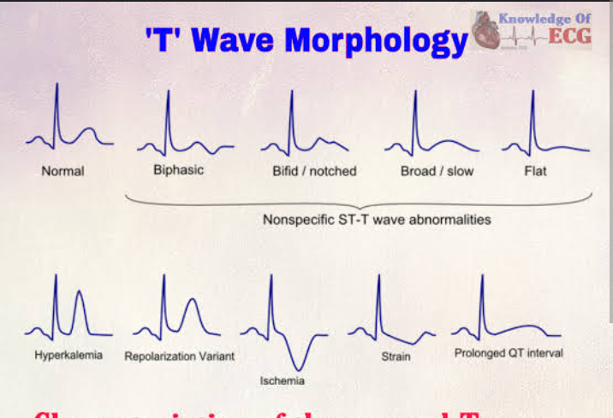
T WAVES MORPHORLOGY

Slide 29
R WAVES
R WAVES IN THE PRECORDIAL LEADS (V1-V6).THE R WAVES NORMALLY INCREASES IN SIZE FROM V1 TO V4 OR V5 THEN DECREASES IN V6.
THIS IS KNOWN AS NORNAL R WAVES PROGRESSION.
A TALL R WAVES IN V1 CAN INDICATE RIGHT VENTRICULAR HYPERTROPHY(RVH)
POOR R WAVES CAN SUGGEST M.I OR HYPERTROPHY

Slide 30
THANK YOU

